Slide 1
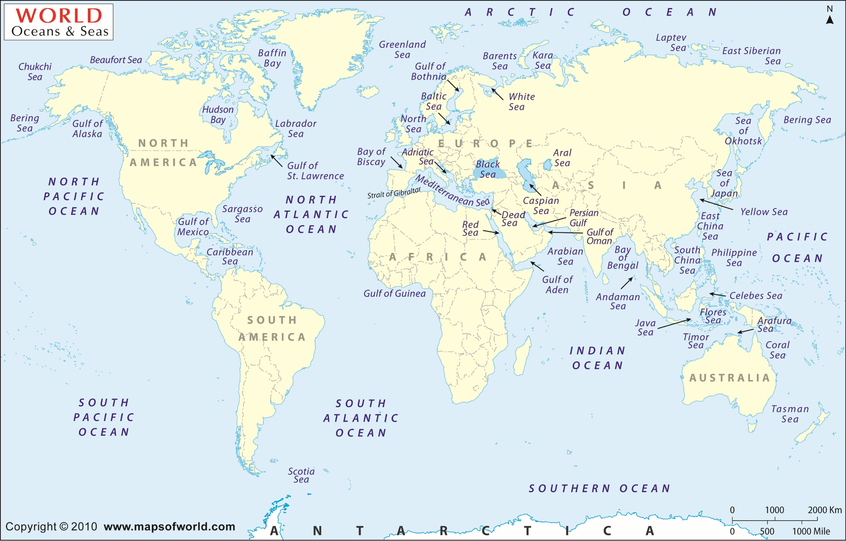
Barter cruises 2009 -2016
Training activity
NIOZ
BMBF
NERC
CSIC
IFREMER
IMR
NSF

